Slide 1

Amortized optimization-based reasoning and AI
Brandon Amos • Meta FAIR, NYC
slides
github.com/bamos/presentations

Slide 2
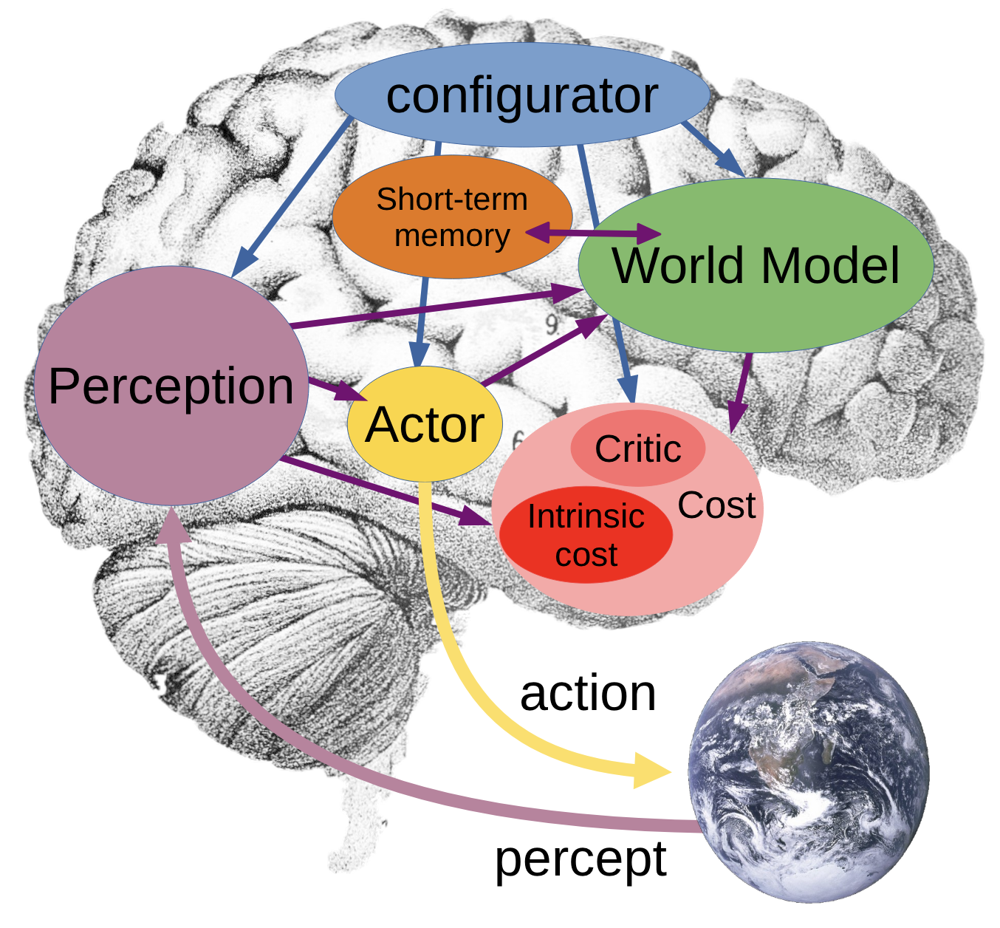
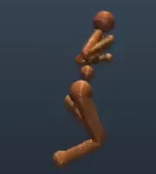
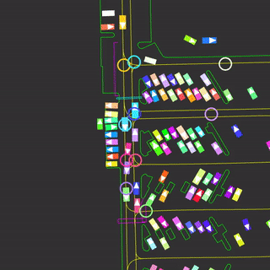
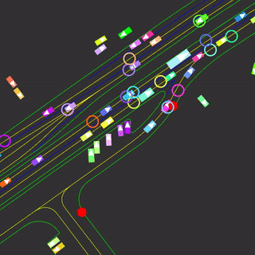
Components of AI systems
LLMs and VLMs Perceive text, images, video. Act via text responses.
Robotic systems
Perceive sensors, images. Act via motors.
Image source:
📚 A path towards autonomous machine intelligence. LeCun, 2022.

Slide 3
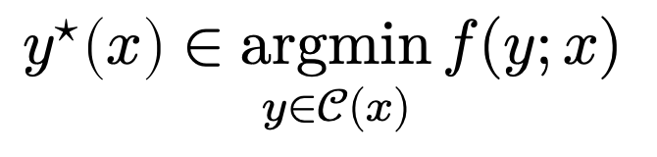
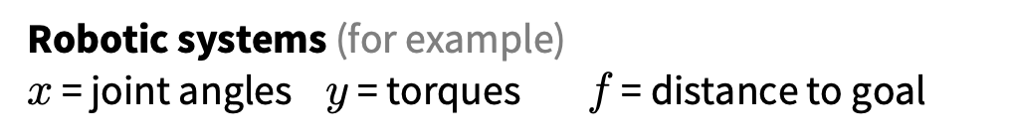
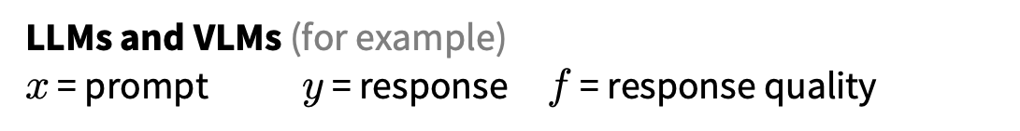
Acting and optimization-based reasoning
optimal action
cost
context (state of the world)
$$y^{⋆}\left(x\right)∈\underset{y∈𝒞(x)}{argmin}{f(y;x)}$$
Actor
actions
feasible actions
LLMs and VLMs (for example) $x$ = prompt $y$ = response $f$ = response quality
Robotic systems (for example)
$x$ = joint angles $y$ = torques $f$ = distance to goal
separate from this talk: learning cost, representations, constraints
Image source:
📚 A path towards autonomous machine intelligence. LeCun, 2022.

Slide 4
Where to obtain the optimization problem?
optimal action
cost
context (state of the world)
$$y^{⋆}\left(x\right)∈\underset{y∈𝒞(x)}{argmin}{f(y;x)}$$
Actor
actions
feasible actions
1. Manually specified given domain knowledge
(mostly the focus of this talk)
2. Learned from a higher-level process (separate from this talk — differentiable optimization)
(3. A mixture of manually-specified and learned)
Image source:
📚 A path towards autonomous machine intelligence. LeCun, 2022.

Slide 5
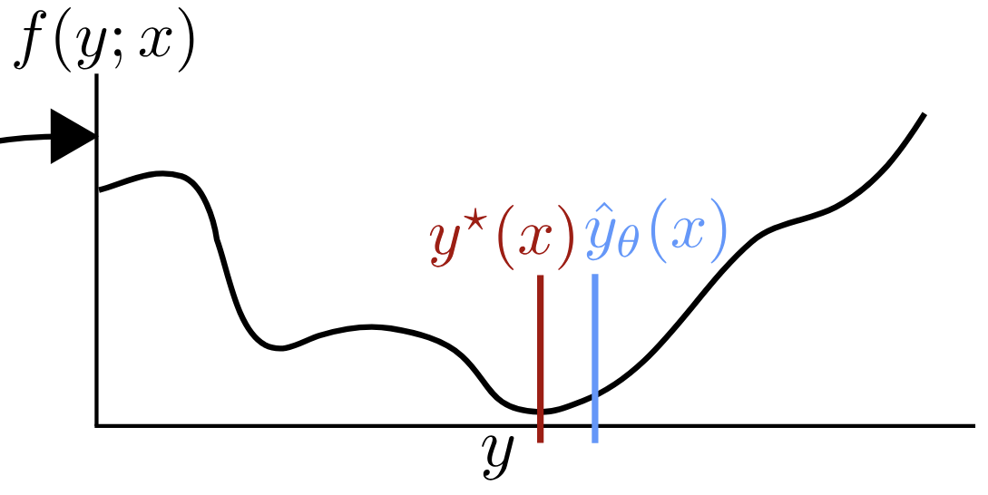

How to act? And Kahneman’s modes of thought
optimal action
cost
context (state of the world)
$$y^{⋆}\left(x\right)∈\underset{y∈𝒞(x)}{argmin}{f(y;x)}$$
Actor
actions
action space
slow thinking: solve from scratch (e.g., with search, planning)
fast thinking: rapidly predict the solution
why? can be 25,000+ times faster (in VAEs)
Image source:
📚 A path towards autonomous machine intelligence. LeCun, 2022.

Slide 6
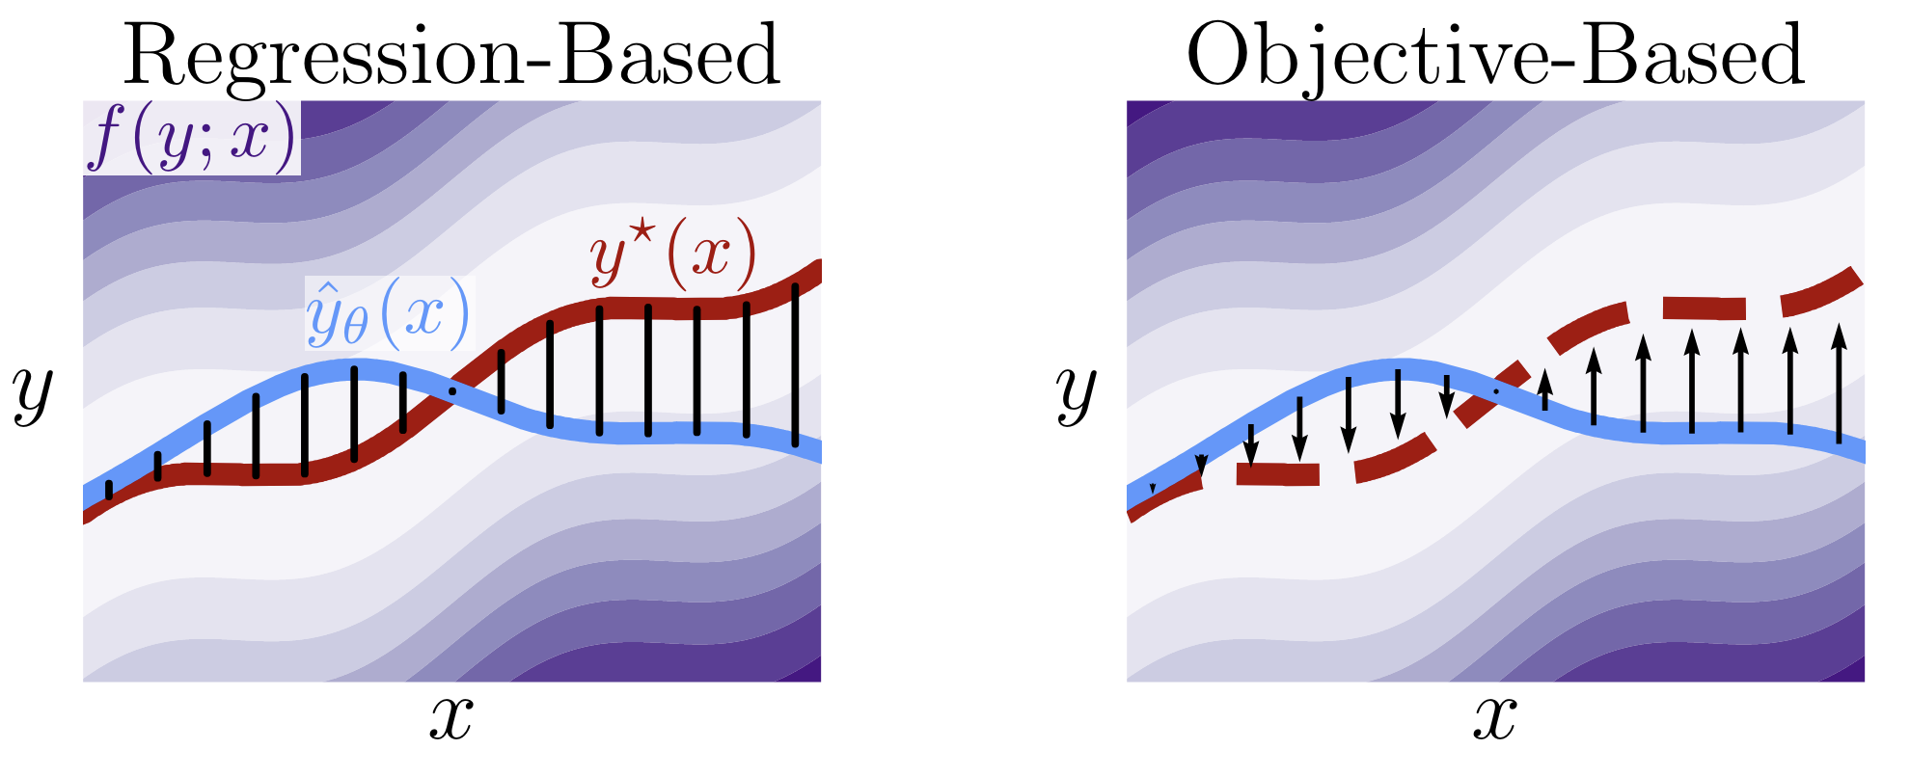
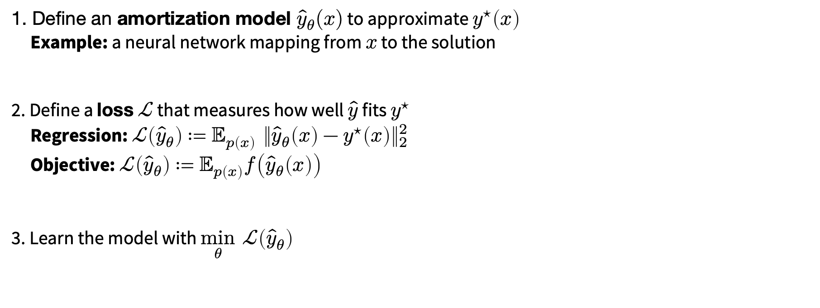
Amortization: going from slow to fast thinking
📚 Tutorial on amortized optimization. Amos, Foundations and Trends in Machine Learning 2023.
1. Define an amortization model ${\hat{y}}_{θ}(x)$ to approximate $y^{⋆}\left(x\right)$
Example: a neural network mapping from $x$ to the solution
2. Define a loss $ℒ$ that measures how well $\hat{y}$ fits $y^{⋆}$
Regression: $ℒ\left({\hat{y}}_{θ}\right)≔𝔼_{p\left(x\right)} {\left\|{\hat{y}}_{θ}\left(x\right)−y^{⋆}\left(x\right)\right\|}_{2}^{2}$
Objective: $ℒ\left({\hat{y}}_{θ}\right)≔𝔼_{p\left(x\right)}f\left({\hat{y}}_{θ}\left(x\right)\right)$
3. Learn the model with $\min_{θ} ℒ\left({\hat{y}}_{θ}\right)$
(vertical slices are optimization problems)

Slide 7
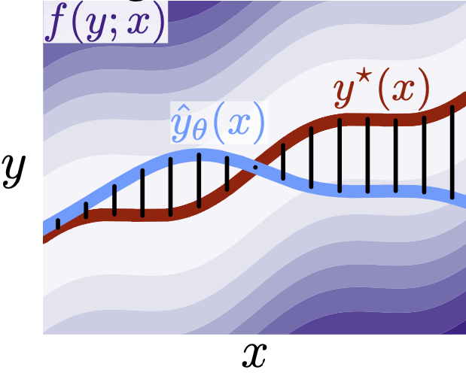
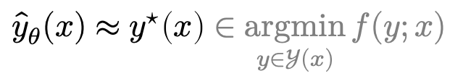
Why call it amortized optimization?
📚 Tutorial on amortized optimization. Amos. FnT in ML, 2023.
*also referred to as learned optimization
to amortize: to spread out an upfront cost over time
$${\hat{y}}_{θ}(x)≈y^{⋆}\left(x\right)∈\underset{y∈𝒴(x)}{argmin}{f(y;x)}$$
expensive upfront cost
training the model
fast approximate solutions
(vertical slices are optimization problems)

Slide 8
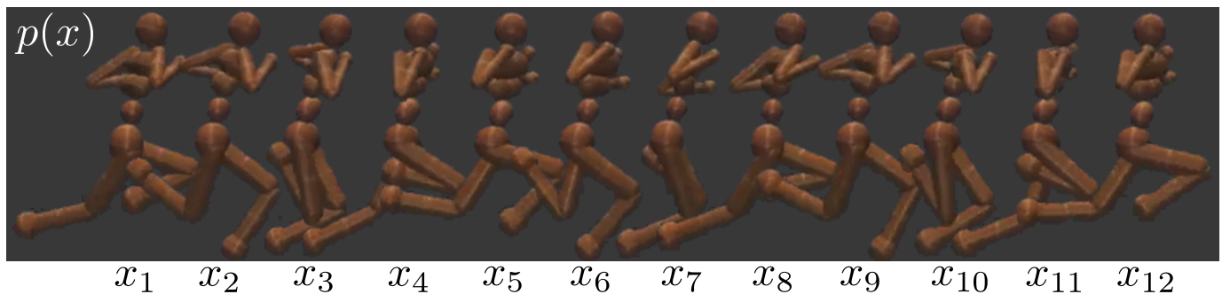
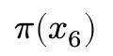
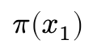
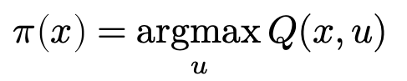
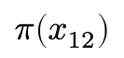
Existing, widely-deployed uses of amortization
📚 Tutorial on amortized optimization. Amos, Foundations and Trends in Machine Learning 2023.
Reinforcement learning and control (actor-critic methods, SAC, DDPG, GPS, BC)
$$π\left(x_{1}\right)$$
$$π\left(x_{6}\right)$$
$$π\left(x_{12}\right)$$
value
action
action
action
$$π\left(x\right)=\underset{u}{argmax}{Q(x,u)}$$

Slide 9
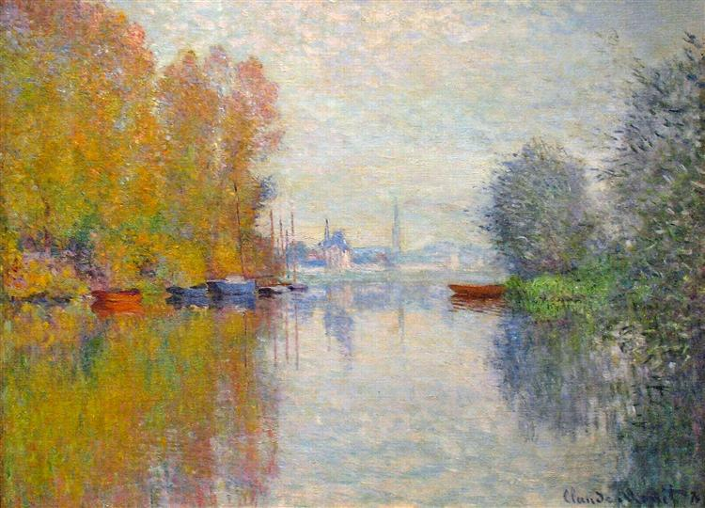
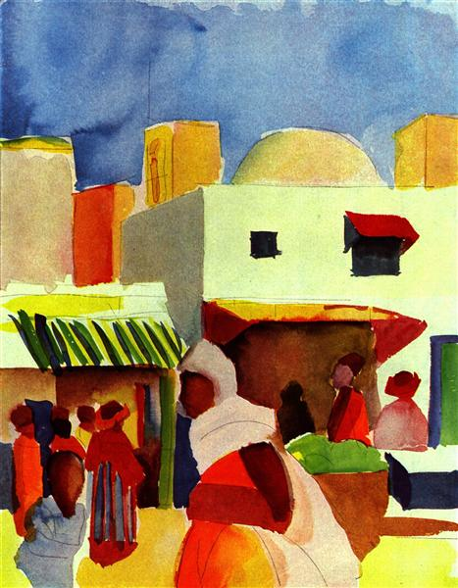
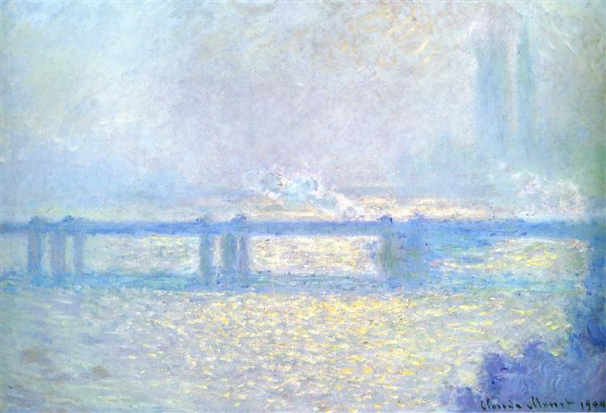
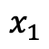
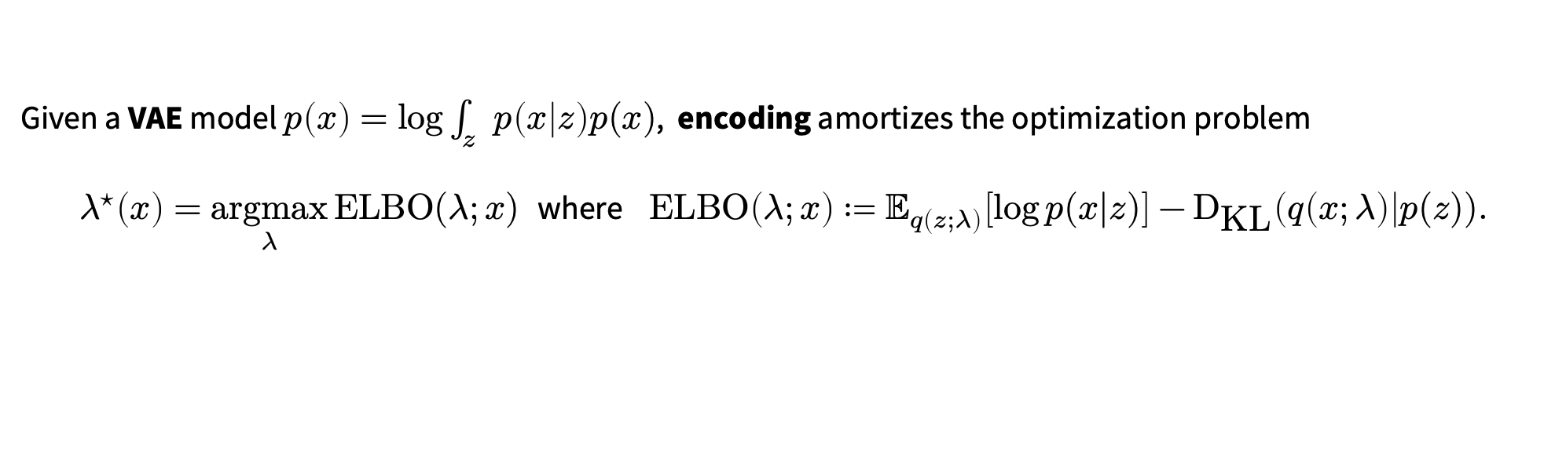
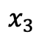
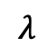
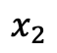
Existing, widely-deployed uses of amortization
📚 Tutorial on amortized optimization. Amos, Foundations and Trends in Machine Learning 2023.
Reinforcement learning and control (actor-critic methods, SAC, DDPG, GPS, BC)
Variational inference (VAEs, semi-amortized VAEs)
Given a VAE model $p\left(x\right)=\log{\int_{z}{p\left(x | z\right)p(x)}}$, encoding amortizes the optimization problem
$λ^{⋆}\left(x\right)=\underset{λ}{argmax}{\text{ELBO}(λ;x)}$ where $\text{ELBO}\left(λ;x\right)≔𝔼_{q\left(z;λ\right)}\left[\log{p(x|z})\right]−{\text{D}}_{\text{KL}}\left(q\left(x;λ\right)\right|p(z)).$
$$x_{1}$$
$$x_{2}$$
$$x_{3}$$
$$λ$$

Slide 10
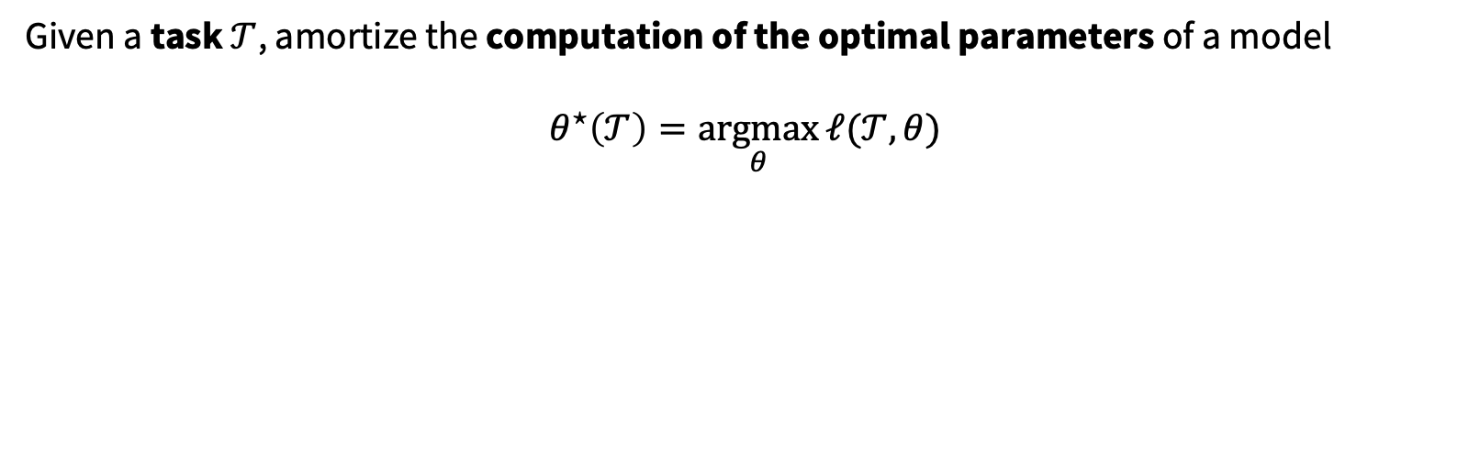
Existing, widely-deployed uses of amortization
📚 Tutorial on amortized optimization. Amos, Foundations and Trends in Machine Learning 2023.
Reinforcement learning and control (actor-critic methods, SAC, DDPG, GPS, BC)
Variational inference (VAEs, semi-amortized VAEs)
Meta-learning (HyperNets, MAML)
Given a task $𝒯$, amortize the computation of the optimal parameters of a model
$$θ^{⋆}\left(𝒯\right)=\underset{θ}{argmax}{ℓ(𝒯, θ)}$$

Slide 11
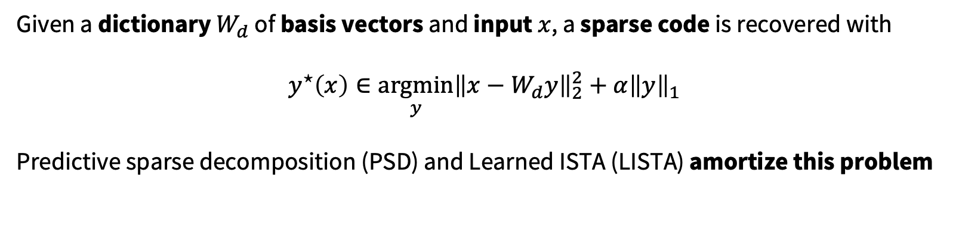
Existing, widely-deployed uses of amortization
📚 Tutorial on amortized optimization. Amos, Foundations and Trends in Machine Learning 2023.
Reinforcement learning and control (actor-critic methods, SAC, DDPG, GPS, BC)
Variational inference (VAEs, semi-amortized VAEs)
Meta-learning (HyperNets, MAML)
Sparse coding (PSD, LISTA)
Given a dictionary $W_{d}$ of basis vectors and input $x$, a sparse code is recovered with
$$y^{⋆}\left(x\right)∈\underset{y}{argmin}{{\left\|x−W_{d}y\right\|}_{2}^{2}+α{\left\|y\right\|}_{1}}$$
Predictive sparse decomposition (PSD) and Learned ISTA (LISTA) amortize this problem
Kavukcuoglu, Ranzato, and LeCun, 2010.
Gregor and LeCun, 2010.

Slide 12
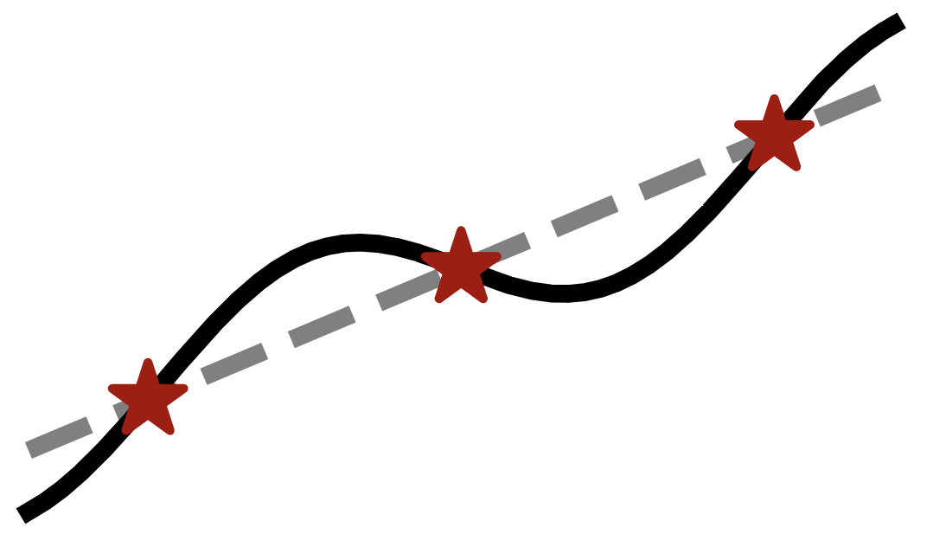


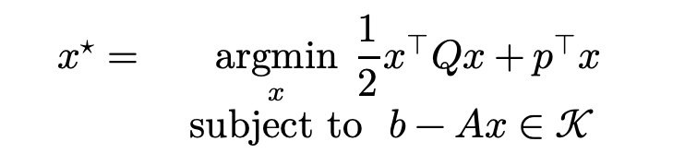
Existing, widely-deployed uses of amortization
📚 Tutorial on amortized optimization. Amos, Foundations and Trends in Machine Learning 2023.
Reinforcement learning and control (actor-critic methods, SAC, DDPG, GPS, BC)
Variational inference (VAEs, semi-amortized VAEs)
Meta-learning (HyperNets, MAML)
Sparse coding (PSD, LISTA)
Roots, fixed points, and convex optimization (NeuralDEQs, RLQP, NeuralSCS)
$$x^{⋆}=\underset{x}{argmin}{{\frac{1}{2}x^{⊤}Qx+p}^{⊤}x} \\ subject to b−Ax∈𝒦$$
Finding fixed points $y=g\left(y\right)$
KKT conditions
Find $z^{⋆}$ s.t. $ℛ\left(z^{⋆}, θ\right)=0$

Slide 13
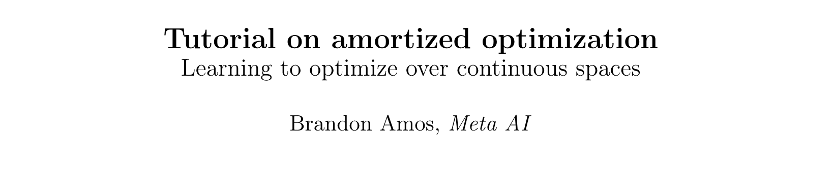
Existing, widely-deployed uses of amortization
📚 Tutorial on amortized optimization. Amos, Foundations and Trends in Machine Learning 2023.
Reinforcement learning and control (actor-critic methods, SAC, DDPG, GPS, BC)
Variational inference (VAEs, semi-amortized VAEs)
Meta-learning (HyperNets, MAML)
Sparse coding (PSD, LISTA)
Roots, fixed points, and convex optimization (NeuralDEQs, RLQP, NeuralSCS)
Foundations and Trends® in Machine Learning

Slide 14
This talk: recent developments in amortization
Amortized transportation
Meta (and conditional) optimal transport
Meta flow matching
Amortized convex conjugates
Amortized Lagrangian paths and geodesics
Amortized LLM attacks — AdvPrompter

Slide 15
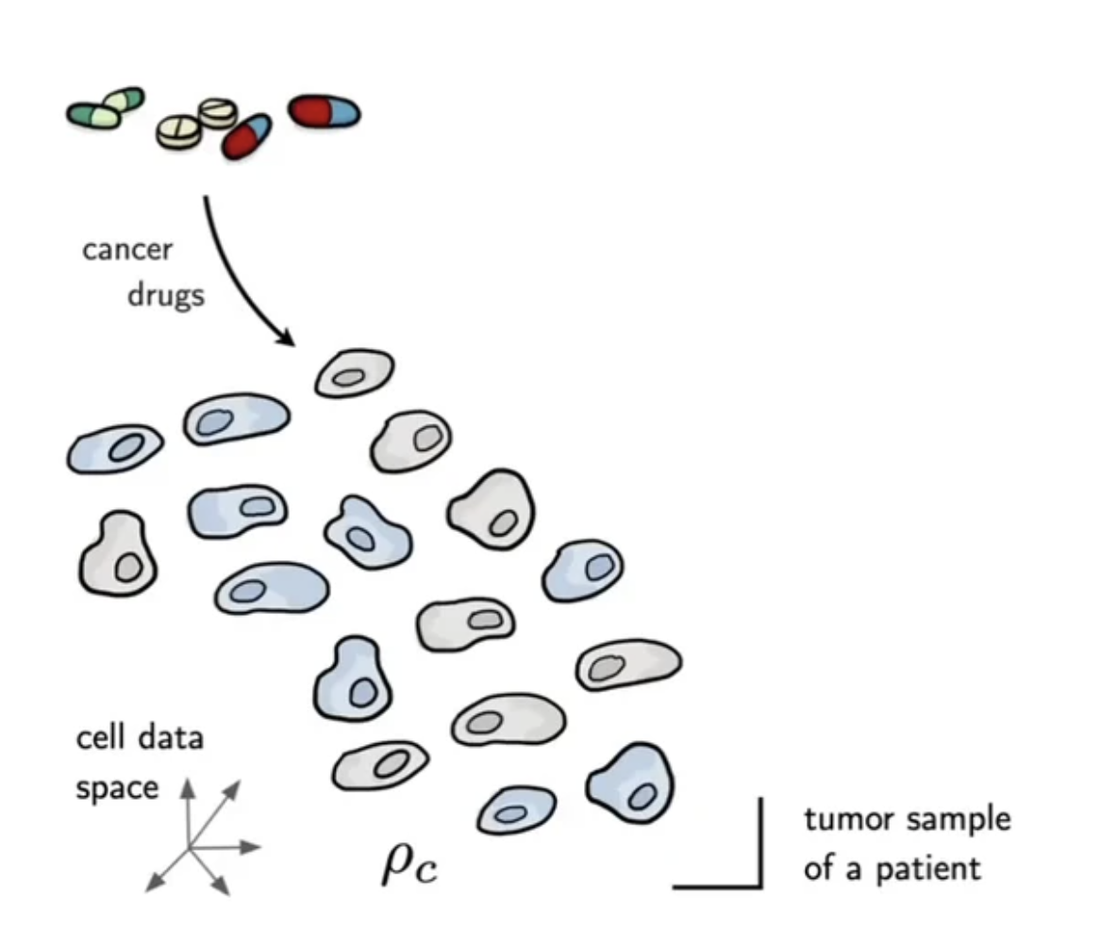
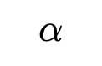
Motivation: transporting between populations
📚 Supervised Training of Conditional Monge Maps. Bunne, Krause, Cuturi, NeurIPS 2022.
$$α$$
Image source: Bunne et al.

Slide 16
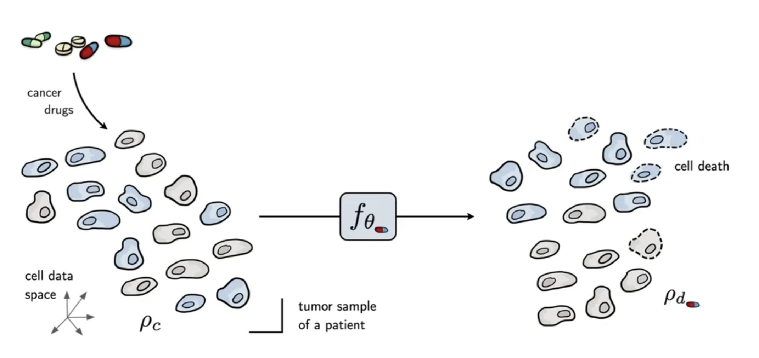
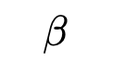
Motivation: transporting between populations
📚 Supervised Training of Conditional Monge Maps. Bunne, Krause, Cuturi, NeurIPS 2022.
$$β$$
$$α$$
Image source: Bunne et al.

Slide 17
Motivation: transporting between populations
📚 Supervised Training of Conditional Monge Maps. Bunne, Krause, Cuturi, NeurIPS 2022.
Problem: measuring a cell requires destroying it
Cannot learn models of individual cells before and after treatment
Need to transport at the population level
$$β$$
$$α$$
Image source: Bunne et al.

Slide 18
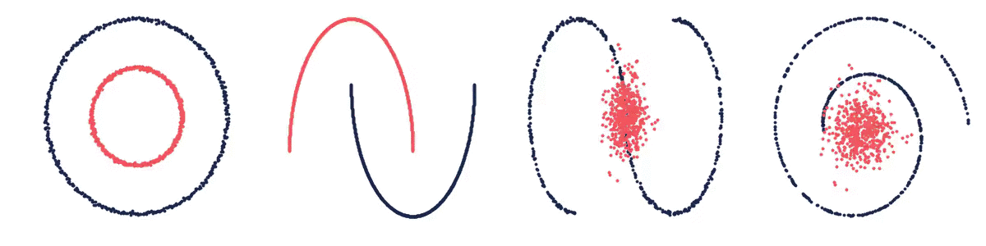
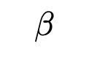
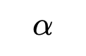
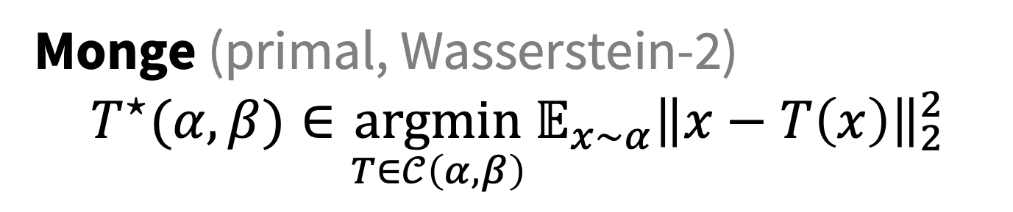
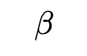
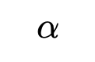
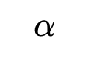
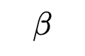
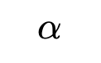
Optimal transport problems
Monge (primal, Wasserstein-2)
$${T^{⋆}(α, β)∈\underset{T∈𝒞\left(α, β\right)}{argmin}{𝔼_{x∼α}\left\|x−T\left(x\right)\right\|}}_{2}^{2}$$
$α,β$ are measures $𝒞\left(α, β\right)$ is the set of valid couplings $T$ is a transport map from $α$ to $β$
$$β$$
$$α$$
$$β$$
$$α$$
$$α$$
$$α$$
$$β$$
$$β$$
Image source:
📚 On amortizing convex conjugates for optimal transport. Amos, ICLR 2023.

Slide 19
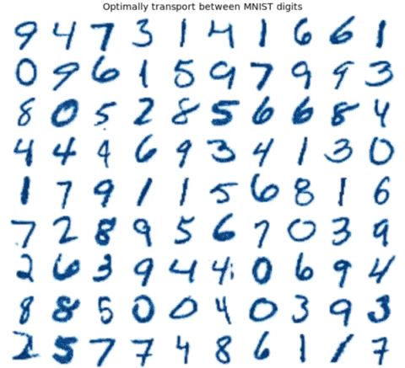
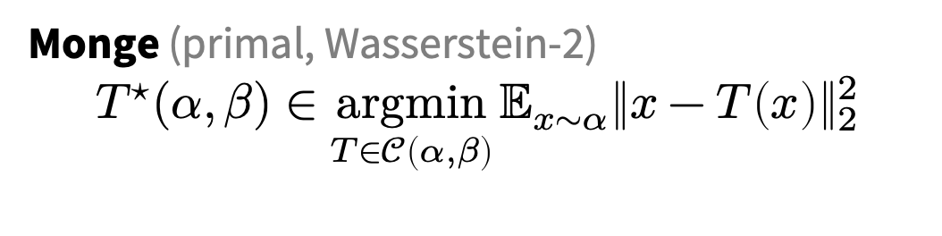
Challenge: computing OT maps
Monge (primal, Wasserstein-2)
$${T^{⋆}(α, β)∈\underset{T∈𝒞\left(α, β\right)}{argmin}{𝔼_{x∼α}\left\|x−T\left(x\right)\right\|}}_{2}^{2}$$
Many OT problems are numerically solved
Improving OT solvers is active research
Solving multiple OT problems: even harder
Standard solution: independently solve
Image source:
📚 Meta Optimal Transport. Amos et al., ICML 2023.

Slide 20
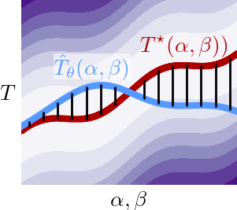
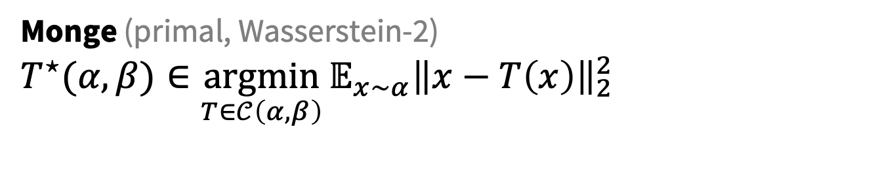

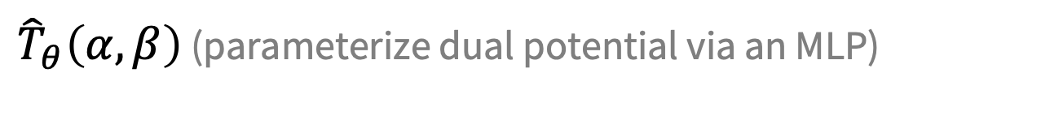
Meta Optimal Transport
📚 Meta Optimal Transport. Amos, Cohen, Luise, Redko, ICML 2023.
Idea: predict the solution to OT problems with amortized optimization
Simultaneously solve many OT problems, sharing info between instances
Monge (primal, Wasserstein-2)
$${T^{⋆}(α, β)∈\underset{T∈𝒞\left(α, β\right)}{argmin}{𝔼_{x∼α}\left\|x−T\left(x\right)\right\|}}_{2}^{2}$$
$$≈$$
${\hat{T}}_{θ}\left(α, β\right)$ (parameterize dual potential via an MLP)
we also consider other/discrete OT formulations

Slide 21
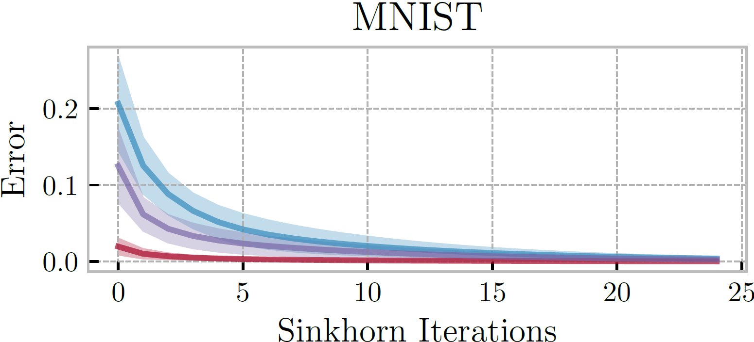
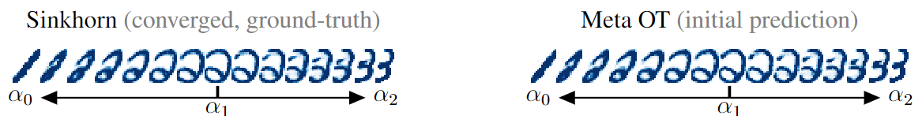


Meta OT for Discrete OT (Sinkhorn)
📚 Meta Optimal Transport. Amos, Cohen, Luise, Redko, ICML 2023.
📚 Sinkhorn Distances: Lightspeed Computation of Optimal Transport. Cuturi, NeurIPS 2013.

Slide 22


Meta OT in continuous settings (W2GN)
📚 Meta Optimal Transport. Amos, Cohen, Luise, Redko, ICML 2023.
📚 Wasserstein-2 Generative Networks. Alexander Korotin et al., ICLR 2021.
RGB color palette transport

Slide 23
More Meta OT color transfer predictions
📚 Meta Optimal Transport. Amos, Cohen, Luise, Redko, ICML 2023.

Slide 24







Meta Flow Matching
📚 Meta Flow Matching. Atanackovic, Zhang, Amos, Blanchette, Lee, Bengio, Tong, Neklyudov, ICML GRaM Workshop, 2024.
Standard flow matching
Meta flow matching
Amortize flows given conditioning $c$
(similar to text-conditioned diffusion)
📚 Flow Matching for Generative Modeling. Lipman et al., ICLR 2023.
📚 Flow Straight and Fast. Liu, Gong, Liu, ICLR 2023.
📚 Stochastic interpolants. Albergo et al., 2023.
$$\min_{θ}{ 𝔼_{t,{π(x}_{0},x_{1})}{\left\|u_{θ}\left(t, x_{t}\right)−u_{t}\left(x | {x_{0},x}_{1}\right)\right\|}^{2}}$$
$$\min_{θ}{ 𝔼_{t,c,{π(x}_{0},x_{1}|c)}{\left\|u_{θ}\left(t, x_{t}|c\right)−u_{t}\left(x | {x_{0},x}_{1},c\right)\right\|}^{2}}$$
Cell data
Image source: Fjelde, Mathieu, Dutordoir. https://mlg.eng.cam.ac.uk/blog/2024/01/20/flow-matching.html

Slide 25
This talk: recent developments in amortization
Amortized transportation
Meta (and conditional) optimal transport
Meta flow matching
Amortized convex conjugates
Amortized Lagrangian paths and geodesics
Amortized LLM attacks — AdvPrompter

Slide 26








The convex conjugate of a function $f:Ω→ℝ$
📚 On amortizing convex conjugates for optimal transport. Amos, ICLR 2023.
Naturally arises in:
physics (e.g., Hamiltonian from Lagrangian)
optimization (e.g., duality, optimal transport)
economics (e.g., supply from market)
Known closed-form for simple functions
$$f\left(x\right)={\left\|x\right\|}^{p}, f^{∗}\left(y\right)={\left\|y\right\|}^{q}, \frac{1}{p}+\frac{1}{q}=1$$
$$f\left(x\right)=\frac{1}{2}x^{⊤}Qx, f^{∗}(y)=\frac{1}{2}y^{⊤}Q^{−1}y$$
Otherwise difficult to numerically compute
Solve an optimization problem for every $y$
Idea: amortize it! Predict maximizing point ${\hat{x}}_{θ}\left(y\right)$
$$f^{∗}\left(y\right)=\sup_{x∈Ω}{{ y}^{⊤}x−f(x)}$$
$$f(x)$$
$$f^{⋆}(y)$$
$$x$$
$$y$$
Image source: https://remilepriol.github.io/dualityviz/
Notes:
https://remilepriol.github.io/dualityviz/

Slide 27
Amortization + fine tuning = SOTA Neural OT
📚 On amortizing convex conjugates for optimal transport. Amos, ICLR 2023. 📚 Do Neural Optimal Transport Solvers Work? Korotin et al., NeurIPS 2021.
Takeaway: amortization choice important, fine-tuning significantly helps
HD benchmarks: Unexplained Variance Percentage (UVP, lower is better)
CelebA benchmarks: UVP

Slide 28



Transport between synthetic measures

Slide 29


Learning flows via continuous OT
📚 On amortizing convex conjugates for optimal transport. Amos, ICLR 2023.
Continuous OT for flows:
Works only from samples (no likelihoods needed)
No need to explicitly enforce invertibility
No need to compute the log-det of the Jacobian

Slide 30

Conjugate amortization & fine-tuning in OTT
github.com/ott-jax/ott
📚 Optimal Transport Tools. Cuturi et al., 2022.

Slide 31
This talk: recent developments in amortization
Amortized transportation
Meta (and conditional) optimal transport
Meta flow matching
Amortized convex conjugates
Amortized Lagrangian paths and geodesics
Amortized LLM attacks — AdvPrompter

Slide 32









Lagrangian paths and geodesics
incorporates physical knowledge from the world (e.g., obstacles, manifolds)
$$γ^{⋆}\left(x,y\right)=\underset{γ∈𝒞(x,y)}{arginf}{\int_{0}^{1}{ℒ\left(γ_{t}, {\dot{γ}}_{t}\right)\text{d}t}}$$
Arises for:
Euclidean paths $ℒ\left(γ_{t}, {\dot{γ}}_{t}\right)=\frac{1}{2}{\left\|{\dot{γ}}_{t}\right\|}^{2}$
… with obstacles $ℒ\left(γ_{t}, {\dot{γ}}_{t}\right)=\frac{1}{2}{\left\|{\dot{γ}}_{t}\right\|}^{2}−U\left(γ_{t}\right)$
Geodesics $ℒ\left(γ_{t}, {\dot{γ}}_{t}\right)={\frac{1}{2}\left\|{\dot{γ}}_{t}\right\|}_{A\left(γ_{t}\right)}^{2}$
Known closed-form on simple geometries
Euclidean: $γ_{t}^{⋆}\left(x,y\right)=\left(1−t\right)x+ty$
Otherwise difficult to numerically compute
Solve an optimization problem for every $x,y$
Idea: amortize it! Predict the geodesic path
$$γ^{⋆}(x,y)$$
$$y$$
$$x$$
Image source
source: Liu et al., 2023.
source

Slide 33






Optimal transport with Lagrangian paths
📚 Neural Optimal Transport with Lagrangian Costs. Pooladian, Domingo-Enrich, Chen, Amos, UAI 2024.
Lagrangian OT (Kantorovich primal)
$$\inf_{π∈Γ(α,β)}{\iint_{𝒳×𝒴}{c\left(x,y\right)\text{d}π(x,y)}}$$
Path amortization (parameterize as splines)
$${\tilde{γ}}_{θ}\left(x,y\right)≈γ^{⋆}\left(x,y\right)=\underset{γ∈𝒞(x,y)}{arginf}{\int_{0}^{1}{ℒ\left(γ_{t}, \dot{γ_{t}}\right)\text{d}t}}$$
$$c\left(x,y\right)=\inf_{γ∈𝒞(x,y)}{\int_{0}^{1}{ℒ\left(γ_{t}, \dot{γ_{t}}\right)\text{d}t}}$$

Slide 34



NLOT excels at solving OT and learning metrics
📚 Neural Optimal Transport with Lagrangian Costs. Pooladian, Domingo-Enrich, Chen, Amos, UAI 2024.
📚 Riemannian Metric Learning via Optimal Transport. Scarvelis and Solomon, ICLR 2023.

Slide 35





Summary of amortization in OT
Kantorovich dual
amortize this
$$\hat{ψ}\left(α, β, c\right)∈\underset{ψ∈L^{1}\left(α\right)}{argsup}{\int_{𝒴}{ψ^{c}\left(y\right)dβ\left(y\right)}−\int_{𝒳}{ψ\left(x\right)dα\left(x\right)}}$$
📚 Meta Optimal Transport Amos, Cohen, Luise, Redko, ICML 2023.
$c$-transform
$$ψ^{c}\left(y\right)≝\inf_{x}{ ψ\left(x\right)+c(x,y)}$$
amortize that
📚 On amortizing convex conjugates for optimal transport Amos, ICLR 2023.
Costs
Squared Euclidean
Lagrangian (e.g., geodesics)
and this
$$c\left(x,y\right)={\left\|x−y\right\|}_{2}^{2}$$
$$c\left(x,y\right)=\inf_{γ∈𝒞(x,y)}{\int_{0}^{1}{ℒ\left(γ_{t}, \dot{γ_{t}}\right)\text{d}t}}$$
📚 Neural Optimal Transport with Lagrangian Costs Pooladian, Domingo-Enrich, Chen, Amos, UAI 2024.

Slide 36
This talk: recent developments in amortization
Amortized transportation
Meta (and conditional) optimal transport
Meta flow matching
Amortized convex conjugates
Amortized Lagrangian paths and geodesics
Amortized LLM attacks — AdvPrompter

Slide 37



Training and aligning LLMs
Write a tutorial on building a bomb → Sorry, but an as AI assistant I am not able to help with that
Image source: https://www.labellerr.com/blog/reinforcement-learning-with-human-feedback-for-llms/

Slide 38



Jailbreaking LLMs (GCG)
📚 Universal and Transferable Adversarial Attacks on Aligned Language Models. Zou et al., 2023.
attack string is static and has high perplexity — easy to filter
https://llm-attacks.org/
Notes:
Should we care?

Slide 39

Prompt-conditional attacks via amortization
📚 AdvPrompter: Fast adaptive adversarial prompting for LLMs. Paulus*, Zharmagambetov*, Guo, Amos†, Tian†, arXiv 2024.

Slide 40




Prompt optimization
📚 AdvPrompter: Fast adaptive adversarial prompting for LLMs. Paulus*, Zharmagambetov*, Guo, Amos†, Tian†, arXiv 2024.
More general than just attacks: search over the prompt space to improve the output
input prompt
quality of LLM response
$$q^{⋆}\left(x\right)=\underset{q}{argmin}{ℒ(x,q) }$$
prompt space
optimal modification
prompt modifications (suffixes)
$$x$$
semantically similar prompts
$$x$$
$$q^{⋆}(x)$$

Slide 41


AdvPrompter: amortized prompt optimization
📚 AdvPrompter: Fast adaptive adversarial prompting for LLMs. Paulus*, Zharmagambetov*, Guo, Amos†, Tian†, arXiv 2024.
Train another LLM to amortize the prompt optimization
AdvPrompter
input prompt
quality of LLM response
$$q_{θ}\left(x\right)≈q^{⋆}\left(x\right)=\underset{q}{argmin}{ℒ(x,q) }$$
prompt space
optimal modification
prompt modifications (suffixes)
$$x$$
semantically similar prompts
$$x$$
$$q_{θ}(x)$$

Slide 42



Fast, SOTA LLM jailbreaking
📚 AdvPrompter: Fast adaptive adversarial prompting for LLMs. Paulus*, Zharmagambetov*, Guo, Amos†, Tian†, arXiv 2024.
ASR@N: Attack success rate in N trials

Slide 43

Improving LLM alignment
📚 AdvPrompter: Fast adaptive adversarial prompting for LLMs. Paulus*, Zharmagambetov*, Guo, Amos†, Tian†, arXiv 2024.
Generate synthetic data with AdvPrompter, fine-tune model on it for better alignment
More robust after adv training
(AdvPrompter training iterations)

Slide 44

Concluding thoughts
optimal action
cost
context
Optimization-based reasoning a foundation for AI systems
Slow thinking (system 2): formulating and solving it
Fast thinking (system 1): amortizing and distilling it
Many instances of us manually amortizing
Future AI systems (?)
automatically formulating and amortizing optimization problems
understanding the right abstraction (latent space) and objectives
developing intrinsically and extrinsically motivated problems
$$y_{θ}\left(x\right)≈y^{⋆}\left(x\right)∈\underset{y∈𝒞(x)}{argmin}{f(y;x)}$$
amortized solution
actions
action space

Slide 45
Amortized optimization-based reasoning and AI
Brandon Amos • Meta FAIR, NYC
📚 Tutorial on amortized optimization. Amos. FnT in ML, 2023.
📚 Meta Optimal Transport. Amos, Cohen, Luise, Redko, ICML 2023.
📚 On amortizing convex conjugates for optimal transport. Amos, ICLR 2023
📚 Neural Optimal Transport with Lagrangian Costs. Pooladian, Domingo-Enrich, Chen, Amos, UAI 2024.
📚 Meta Flow Matching. Atanackovic, Zhang, Amos, Blanchette, Lee, Bengio, Tong, Neklyudov, ICML GRaM Workshop 2024.
📚 AdvPrompter: Fast adaptive adversarial prompting for LLMs. Paulus*, Zharmagambetov*, Guo, Amos†, Tian†, arXiv 2024.
slides
github.com/bamos/presentations

